Slide 1
Rural Hospitals
Ashlynn Wimer
are partial closures a cure?

Slide 2
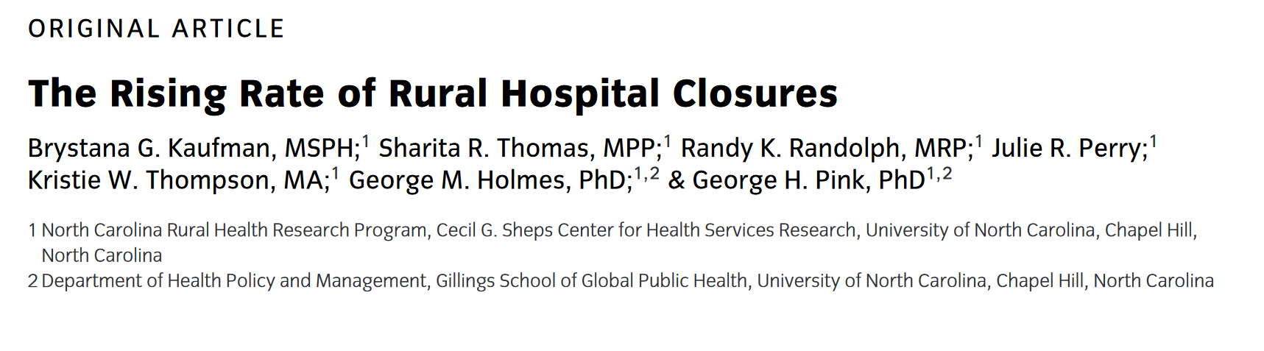
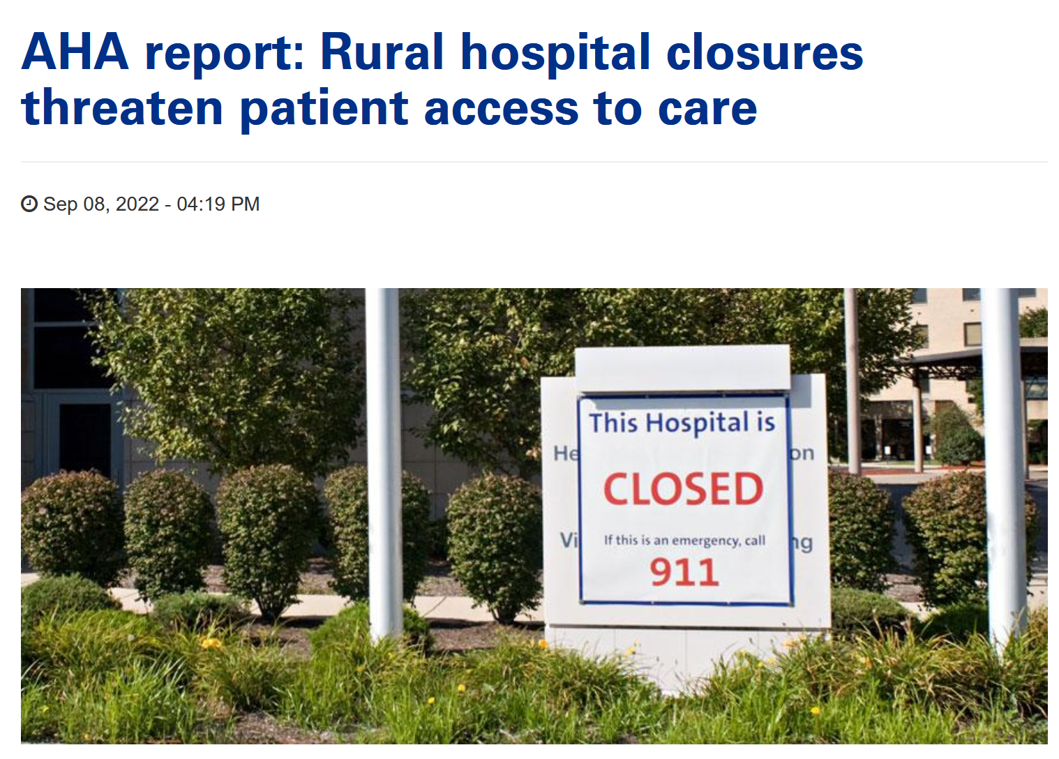
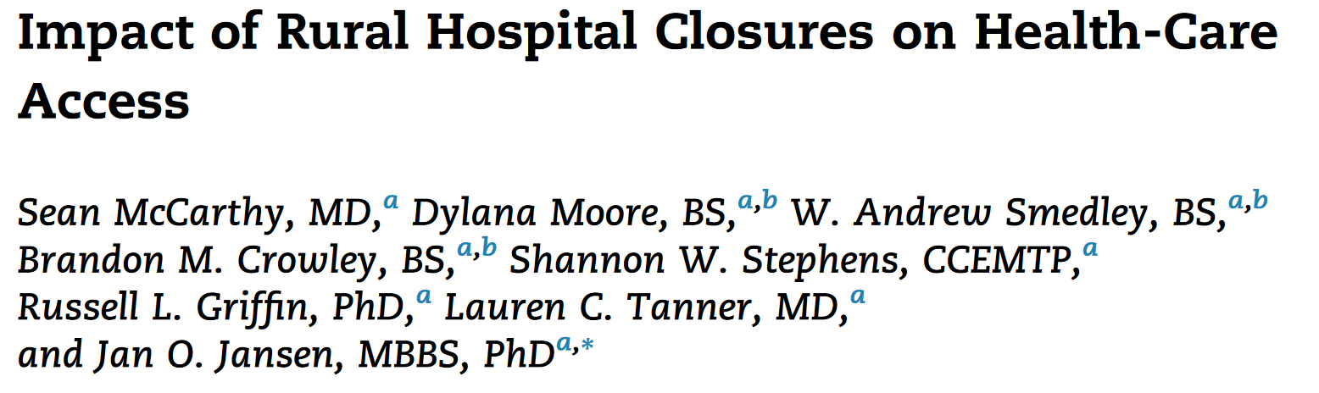
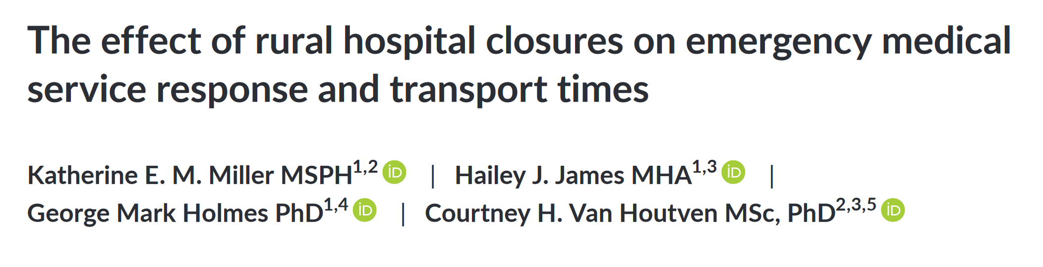
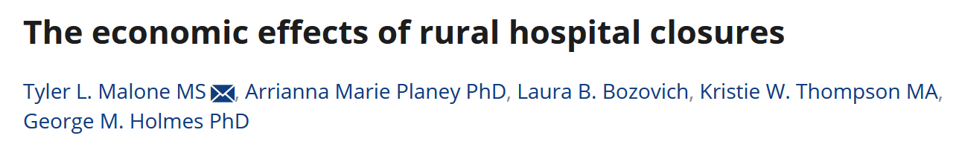

Slide 3




Slide 4

People find it important to live near a hospital.
2)Young people are
more likely to move
than old people.

Slide 5




Slide 6
Surely there’s a good case study for this! There’s been so many closures, and the Census provides data!
“
”
- a more innocent me, earlier in the quarter.

Slide 7
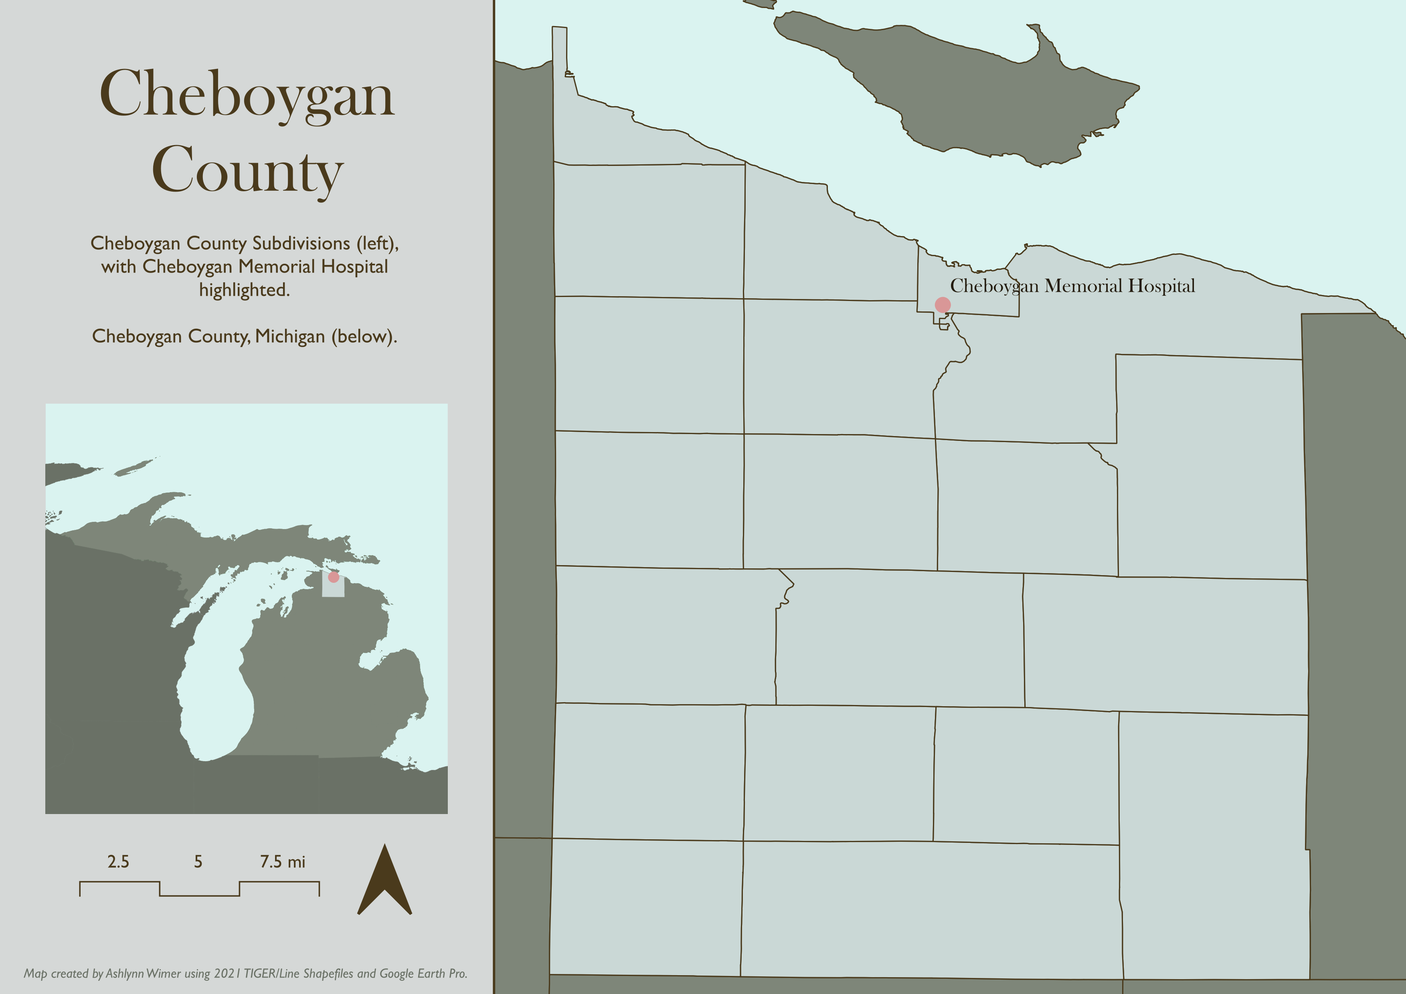
In 2012, Cheboygan Memorial Hospital – a rural hospital in Cheboygan County, Michigan – closed, before reopening a few months later.

Slide 8
Research Questions
RQ1)
Did the Cheboygan Memorial Hospital closure increase per capita outmigration rates as measured by 2011 and 2016 ACS 5-Year estimates at the county subdivision and county levels?
RQ2)
Did the Cheboygan Memorial Hospital closure decrease median income or unemployment rates as measured by 2011 and 2016 ACS 5-Year estimates at the county subdivision and county levels?

Slide 9
Preliminary Results
Alternatively: “Huh. Looks like it didn’t do much!”

Slide 10
An Important Note
ACS 2016 5-Year Estimate
ACS 2011 5-Year Estimate

Slide 11
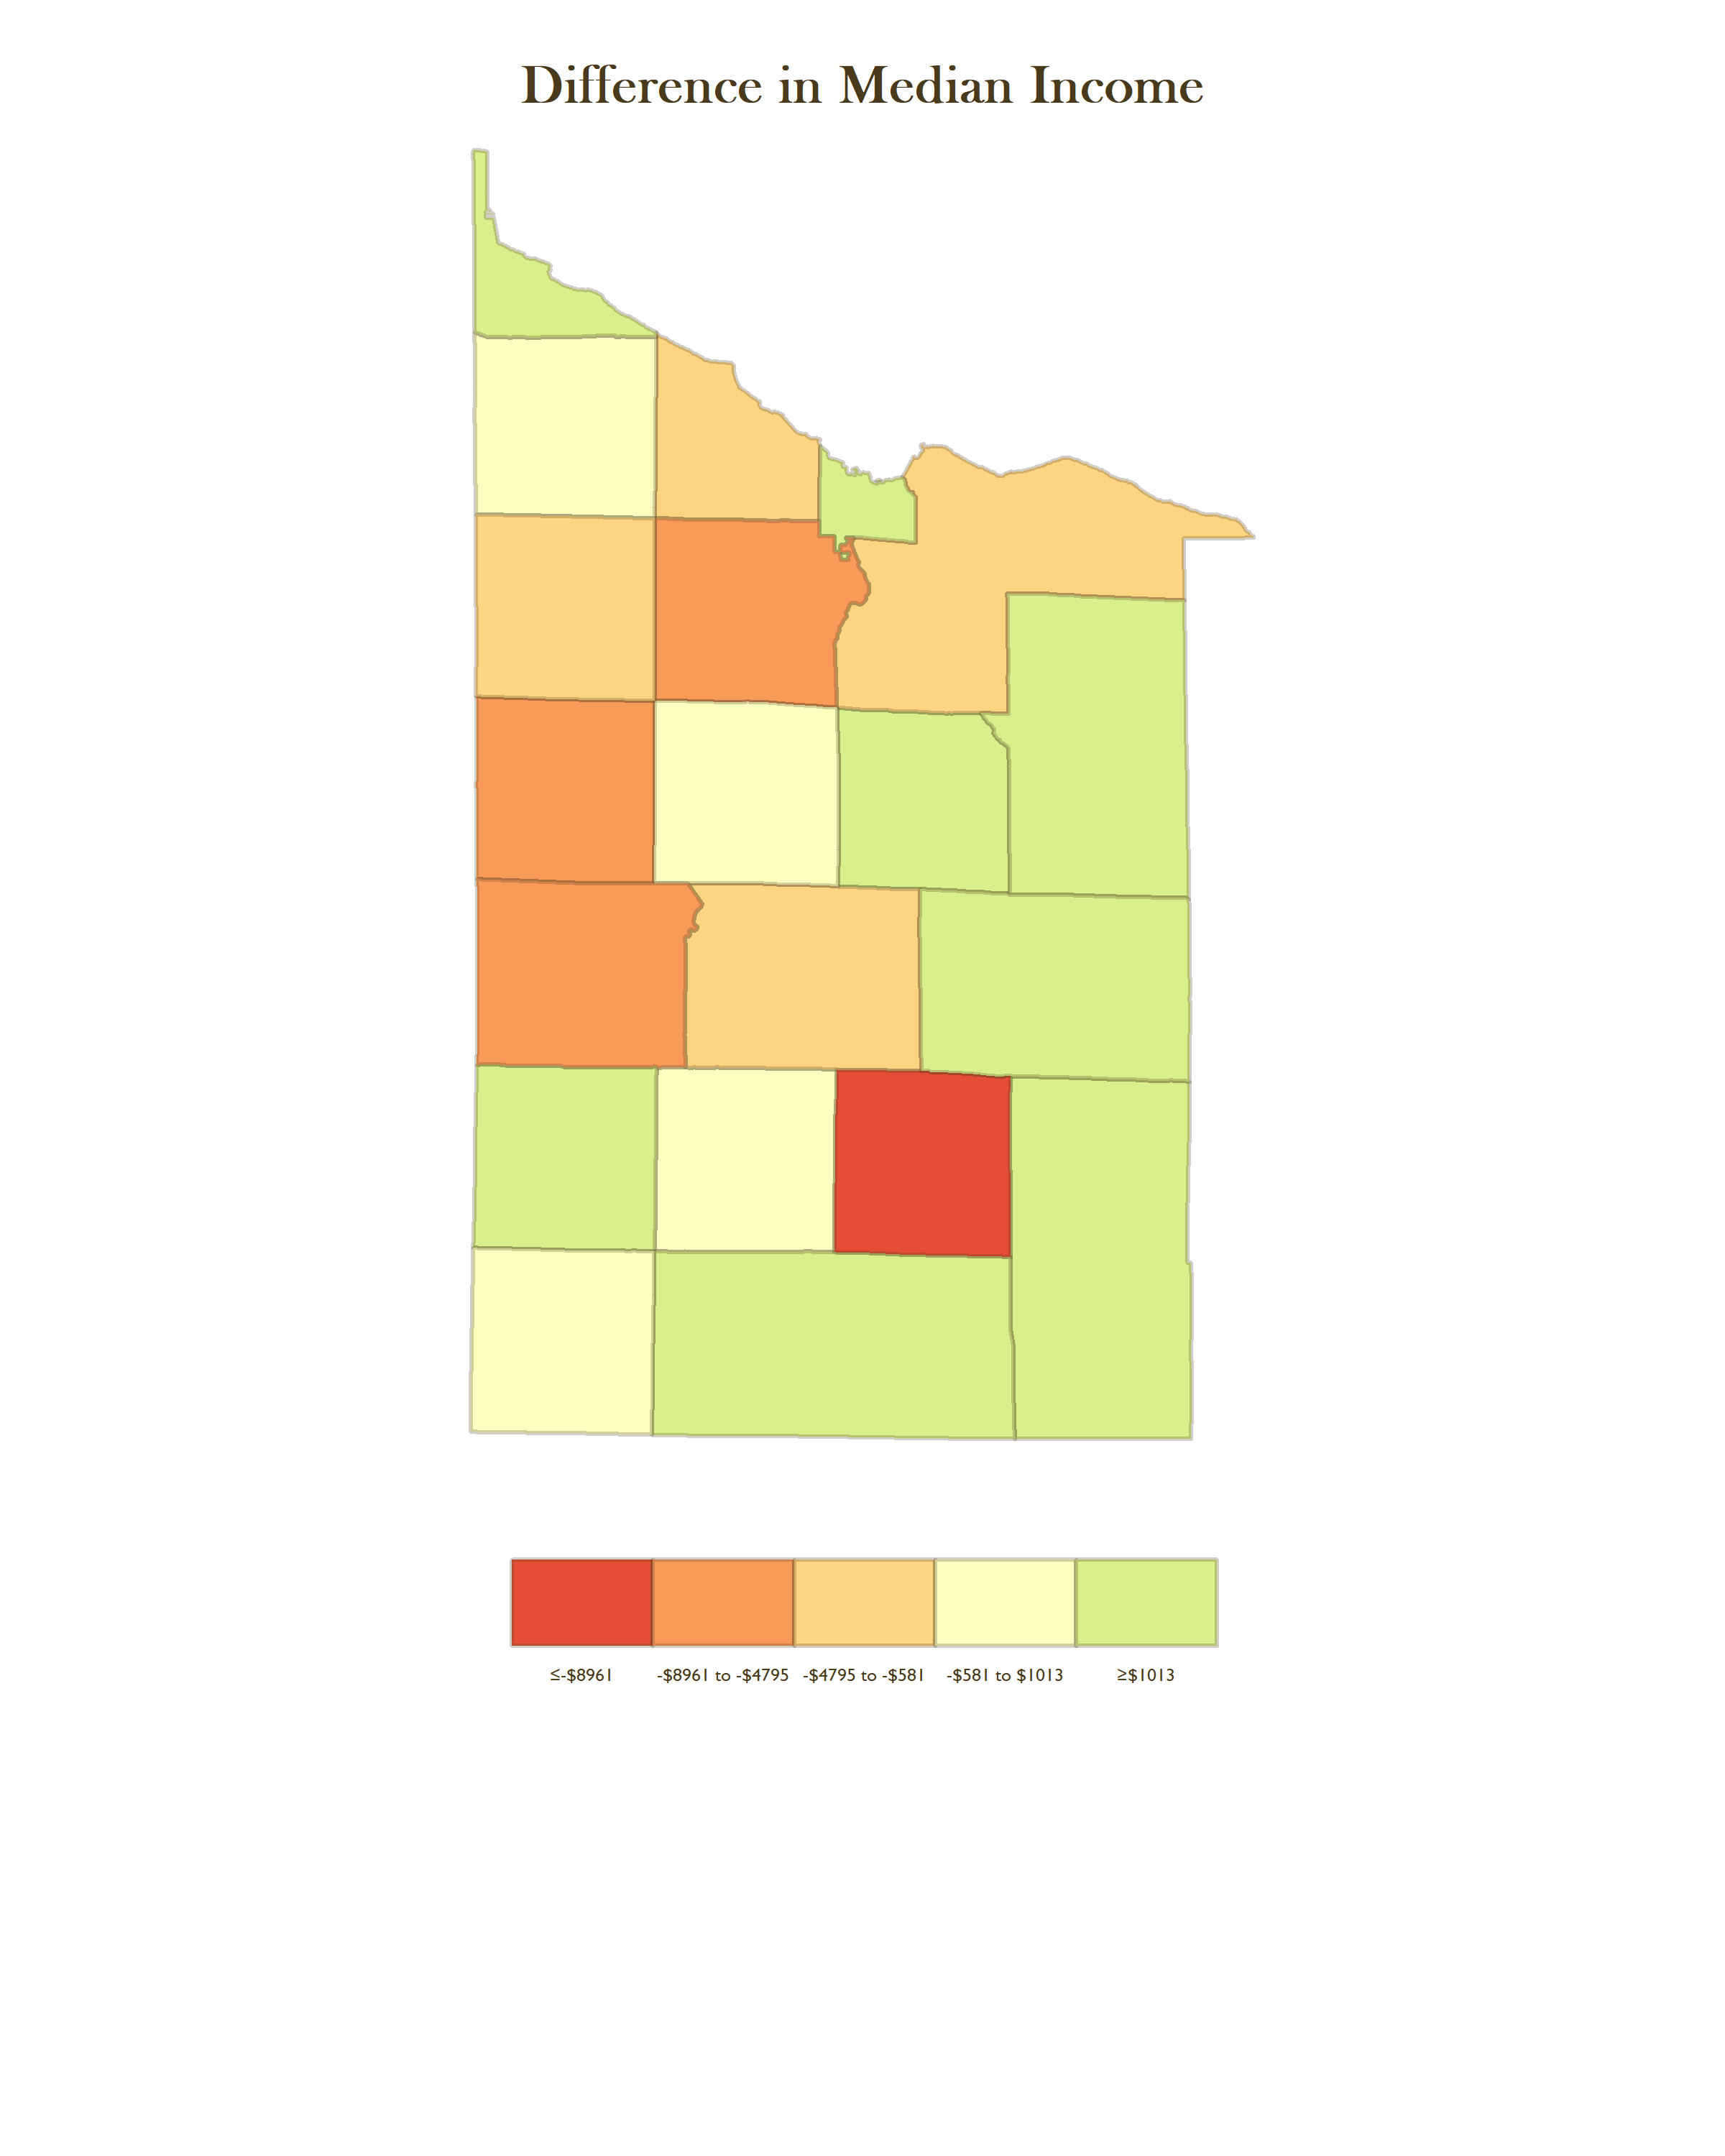
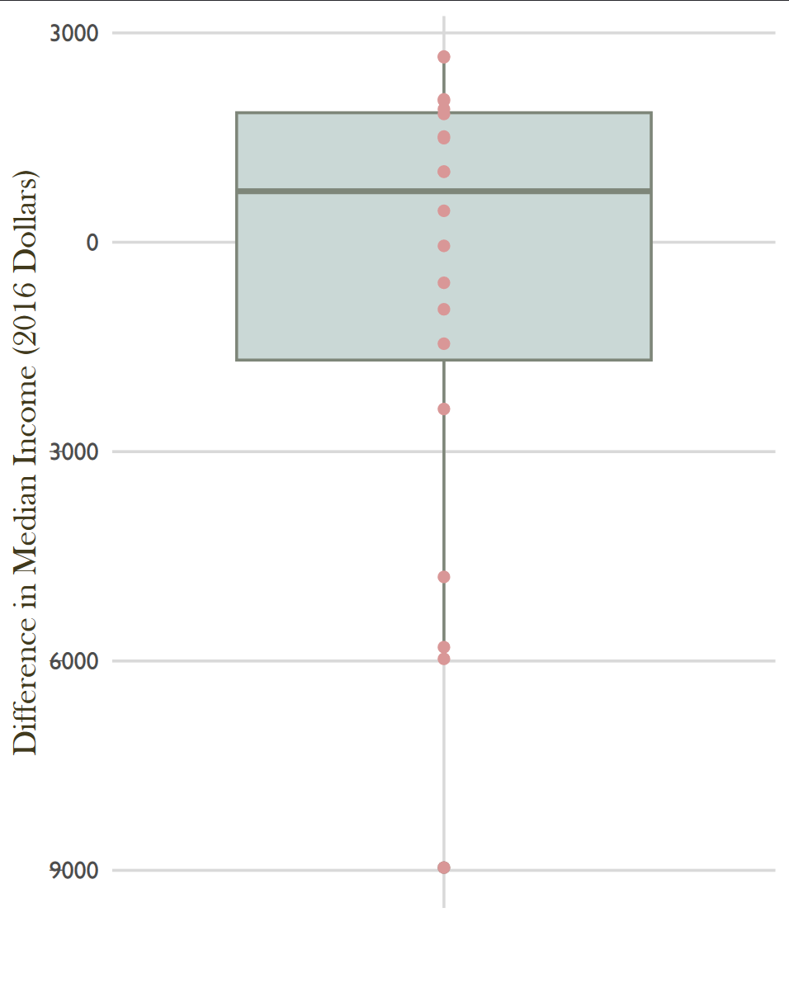
≥$1013
$1013 to
-$581
-$581 to -$4795
-$4795 to -$8961
≤-$8961

Slide 12
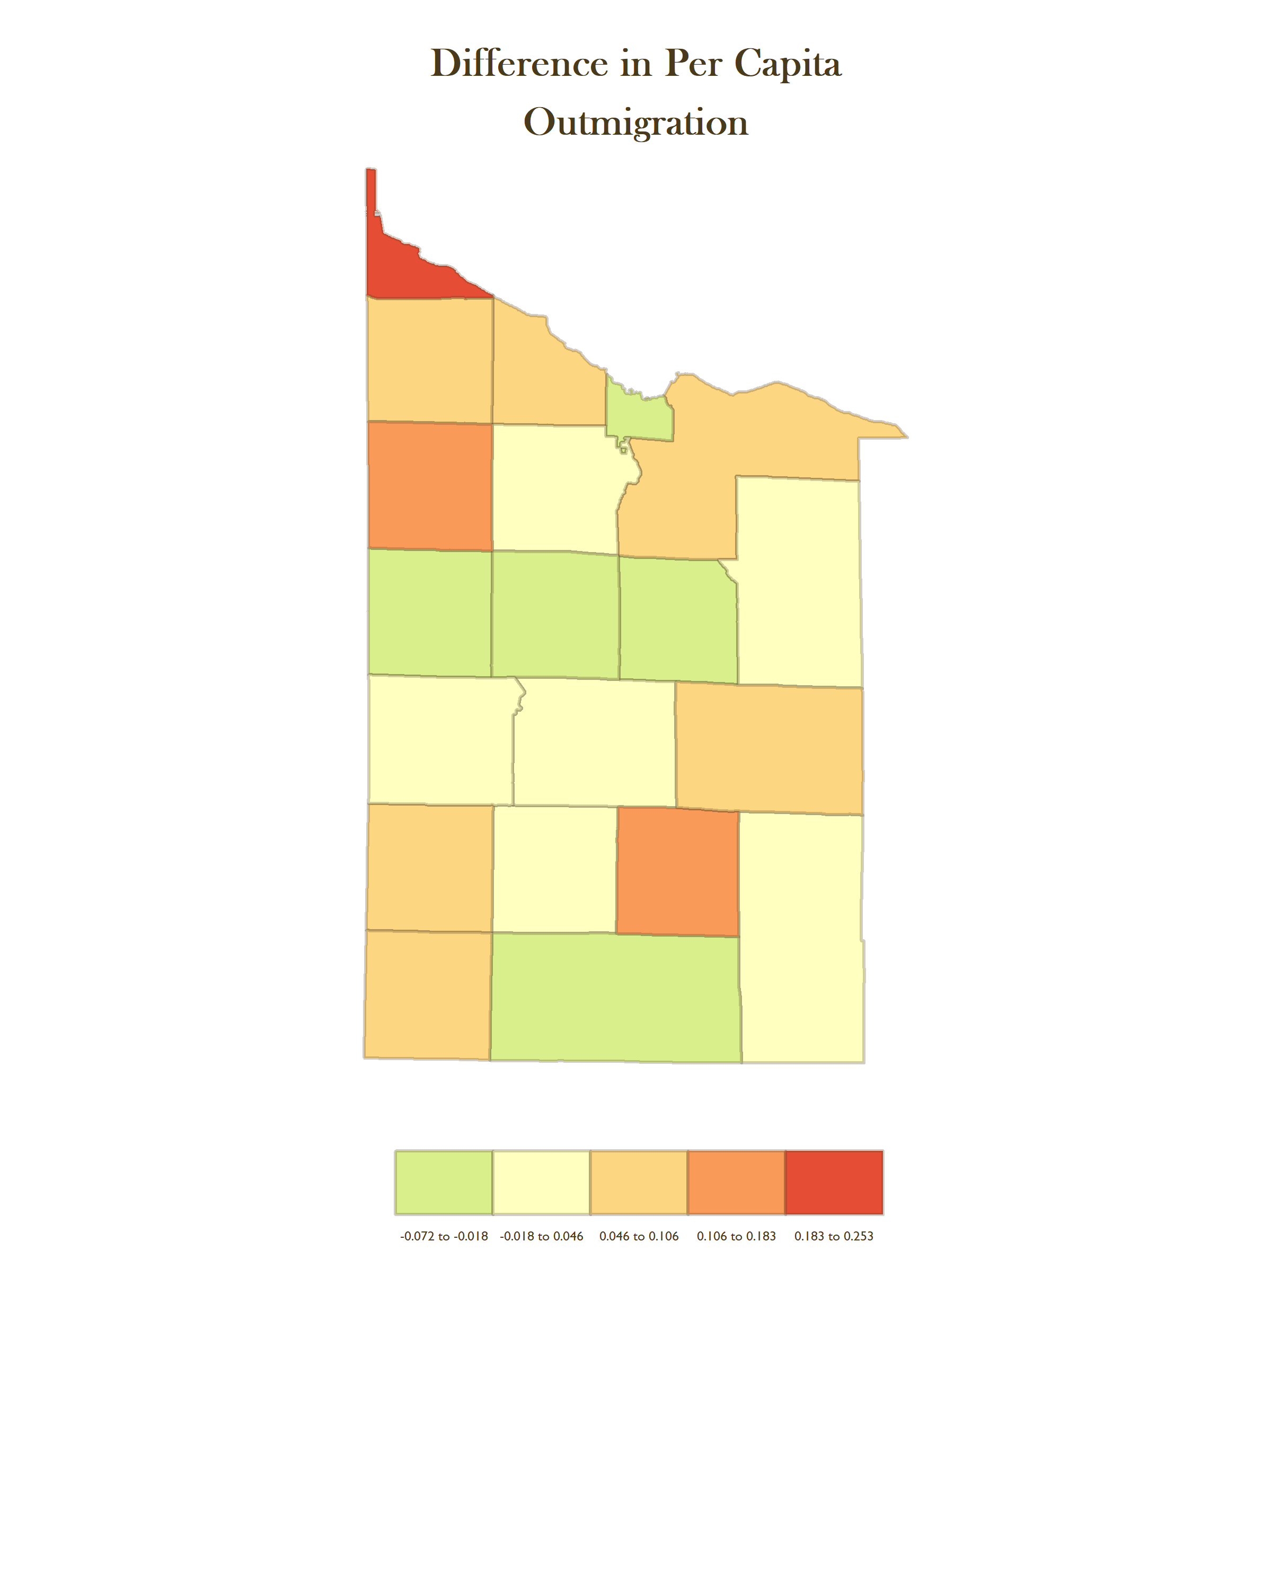
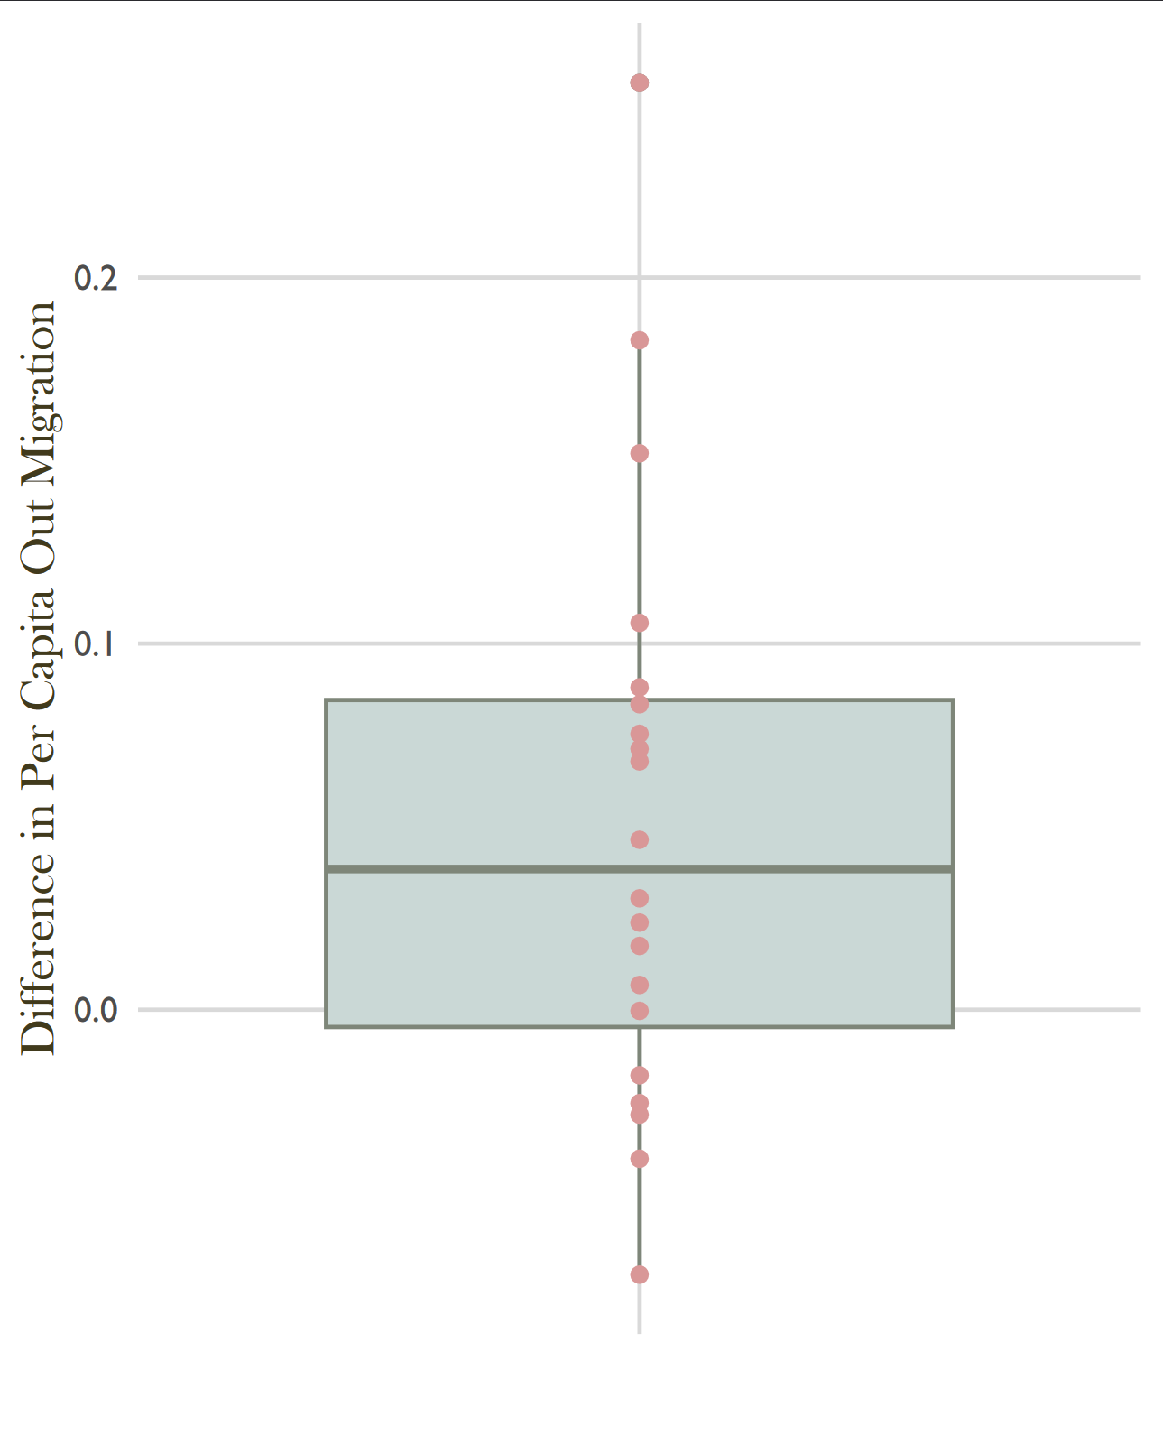
≥0.183
0.183 to 0.106
0.106 to 0.46
0.046 to
-0.018
≤ -0.018

Slide 13
References
American Hospital Association. (2022). Rural Hospital Closures Threaten Access: Solutions to Preserve Care in Local Communities. American Hospital Association. https://www.aha.org/system/files/media/file/2022/09/rural-hospital-closures-threaten-access- report.pdf
Kaufman, B. G., Thomas, S. R., Randolph, R. K., Perry, J. R., Thompson, K. W., Holmes, G. M., & Pink, G. H. (2016). The Rising Rate of Rural Hospital Closures. The Journal of Rural Health, 32(1), 35–43. https://doi.org/10.1111/jrh.12128
Malone, T. L., Planey, A. M., Bozovich, L. B., Thompson, K. W., & Holmes, G. M. (2022). The economic effects of rural hospital closures. Health Services Research, 57, 614–623. https://doi.org/10.1111/1475- 6773.13965
McCarthy, S., Moore, D., Smedley, W. A., Crowley, B. M., Stephens, S. W., Griffin, R. L., Tanner, L. C., & Jansen, J. O. (2021). Impact of Rural Hospital Closures on Health-Care Access. Journal of Surgical Research, 258, 170–178. https://doi.org/10.1016/j.jss.2020.08.055
Miller, K. E. M., James, H. J., Holmes, G. M., & Van Houtven, C. H. (2020). The effect of rural hospital closures on emergency medical service response and transport times. Health Services Research, 55(2), 288– 300. https://doi.org/10.1111/1475-6773.13254
Sørensen, J. F. L. (2008). The potential migration effect of rural hospital closures: A Danish case study. Scandinavian Journal of Public Health, 36, 460–466. https://doi.org/10.1177/1403494808089554

